Slide 1
The Relational Model
Our Mathematical Foundation

Slide 2
Origins
First proposed by E.F. Codd, 1969-70
  subsequently modified and extended
An abstract theory of data
  based on aspects of maths
Basis of most modern DBMS
  none implement it entirely
  we can compare them with the idea

Slide 3
3 Aspects of the Model
It concerns
  1) data objects
    storing it
  2) data integrity
    making sure it corresponds to reality
  3) data manipulation
    working with it

Slide 4
Relational Data Objects
Storing it

Slide 5
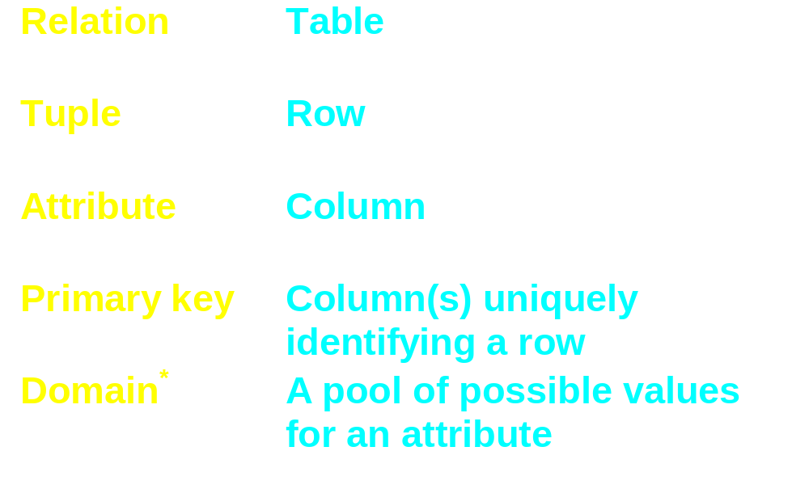
Informal concept definitions

Slide 6
Domain
Pool of possible values for an attribute
Each tuple has one of these values for the attribute
Allows meaningful comparisons
They are data types
  supported poorly in most systems
  no user defined types

Slide 7
Relation
Based on a collection of domains
Heading
  a set of name:domain pairs
    {<A1:D1>, <A2:D2>, <A3:D2>, …… <An:Dn>}
Body
  a set of tuples
  each tuple is a set of name:value pairs
    {<A1:V1>, <A2:V2>, <A3:V3>, …… <An:Vn>}

Slide 8
Are Relations Tables?
A table is a practical way to write down a relation
Relations are defined on sets
  a set of headings, a set of tuples …
  sets have no ordering
  attributes come in no particular sequence
    columns do have sequence
  tuples come in no particular sequence
    rows do have sequence

Slide 9
Properties of Relations
There are no duplicate tuples
Tuples are unordered
Attributes are unordered
All attribute values are atomic

Slide 10
Atomic Values
Strings have characters
  not the problem

Slide 11
Relational Data Objects
End

Slide 12
Data Integrity
making sure it corresponds to reality

Slide 13
A database as a model
We meet lot of “models” in DB work
Here we mean that the DB must reflect reality
  the attribute values and their combination must represent the (partial) true state of the world
We can really only ensure that the values are plausible
We do this by implementing integrity rules

Slide 14
Database-specific integrity rules
We only sell floppies in multiples of 10
Only senior managers and sales reps can have cars over 2000cc
British car registrations must be of the form: A DDD AAA
  where A = alphabetic, D = digit
A temperature must be between −273.15 and ???

Slide 15
General Integrity Rules
Application-specific rules are just that
  must be identified and implemented
  we will return to this
There are two integrity features of general applicability
  candidate/primary keys
  foreign keys
Part of the relational model

Slide 16
Candidate Keys
A candidate key for relation R is a subset K of the attributes of R such that
  no two tuples of R have the same value of K
  the “uniqueness property”
  no proper subset of K has the uniqueness property
  the “irreducibility property”
All relations have at least 1 (everything)
  may have several
Uniqueness applies to all possible tuples
  not just the current ones

Slide 17
What are candidate keys for?
Tuple-level addressing
  allows unambiguous identification of 1 tuple
The tuple where X has value Y
  ambiguous unless X is a candidate key
They are not indices
  or any other special (physical) access mechanism
    though these may be implemented using them

Slide 18
The primary key
A specified candidate key
May only be one candidate
Otherwise the choice is arbitrary
  though practical factors may help decide
It is common to think only of the primary key
  we will almost always do this
  but remember there may be other candidates

Slide 19
Foreign Keys
Commonly a particular value for an attribute is only plausible if it appears elsewhere

Slide 20
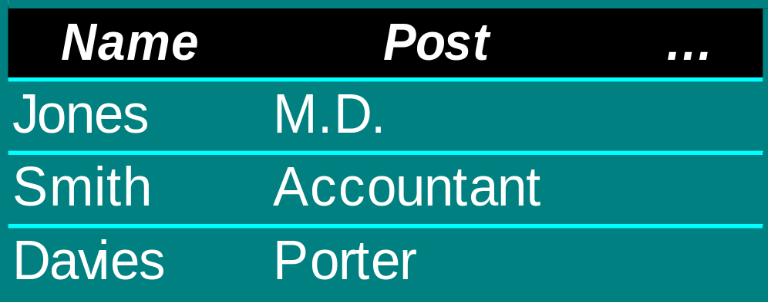
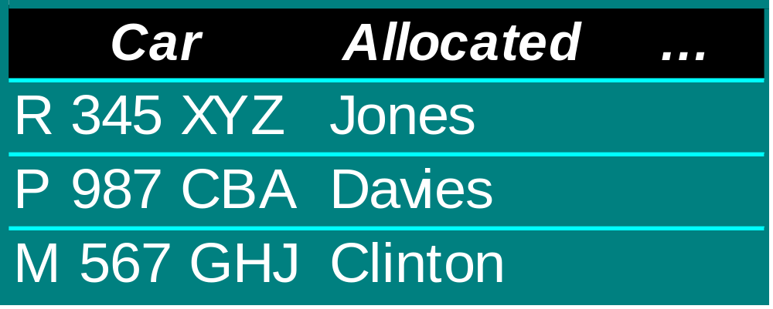
Foreign Keys
No car
- OK
Not an
employee
- implausible

Slide 21
Foreign Keys - definition
Relation R2
Foreign key in R2 is a subset (FK) of its attributes such that:
  there is a relation R1 with a candidate key CK
  for all time, each value of FK in R2 is identical to the value of CK in some tuple of R1
Tours and Operators?

Slide 22
Foreign keys - notes
All keys are sets of attributes
A candidate key can contain a value not currently found in the foreign key
Chains of references can build up
Relations can reference themselves
  personnel relation can have a “manager” attribute - managers are personnel

Slide 23
Referential Integrity
The database must not hold any unmatched foreign keys
The DBMS should prevent the situation arising - most do today
The DBMS can:
  reject operation which would compromise integrity
  or
  make other changes to retain integrity

Slide 24
Maintaining R. Integrity
Attempt to delete the target of a foreign key
  only allow if there is no matching FK value
or
  cascade - delete tuples with FK matches
Attempt to update the candidate key
  only allow if there is no matching FK value
or
  cascade - update the FK in the matching tuples
Tours and Operators?

Slide 25
Data Integrity
End

Slide 26
Data Manipulation
working with it

Slide 27
Relational Algebra
A set of operators
Take relations as operands
Return relations as results
c.f. arithmetic operators
  2 + 2 returns 4
  R1 op R2 returns R3

Slide 28
Relational Closure
The output of a relational operation is a relation
  put simply, we always work with “tables”
The output of one operation can be the input to the next
  we are familiar with the concept in arithmetic
    2 + (4 x 3) - (28 / 4)
The great trick!

Slide 29
Operators
Any number could be defined
8 originals
  4 traditional set operations (modified)
    union, intersection, difference, Cartesian produce
  4 special relational operations
    restrict, project, join and divide
We will also look at 2 more
    extend, summarize

Slide 30
Type Compatibility
Having the same set of attributes
  with corresponding attributes defined on the same domains
Some operators require this
  some don’t
“adding apples and oranges”

Slide 31
The 4 set operators
Union
Intersection
Difference (Minus)
Product (Times)

Slide 32
Union operator
Requires type compatibility
A UNION B
  returns a relation with
    the same heading as A or B
    the set of all tuples in A or B or both

Slide 33



Union
UNION
Duplicates
eliminated
Returns

Slide 34
Intersection operator
Requires type compatibility
A INTERSECTION B
  returns a relation with
    the same heading as A or B
    the set of all tuples belonging to both A and B

Slide 35



Intersection
Intersection
Returns

Slide 36
Difference operator
Requires type compatibility
A DIFFERENCE B
  returns a relation with
    the same heading as A or B
    the set of all tuples belonging to A and not to B

Slide 37



Difference
Difference
Directionality
Returns

Slide 38
Product operator
Does not requires type compatibility
A PRODUCT B
  returns a relation with
    the heading of A and B
    the set of all tuples formed by coalescing all tuples from A with all tuples from B
Not of practical use
No extra information
Theoretical value

Slide 39


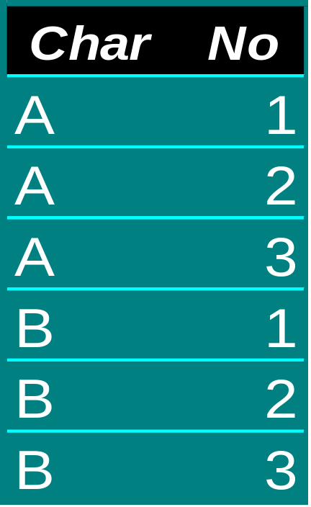
Product
Product
Returns

Slide 40
Product operator - note
If the headers have names in common
  product would have duplicated attributes
    not a “well formed” relation
  must rename one or both
    R1(a,b,c) Product R2(c,d,e)
    might be made to return
    R3(a,b,c1,c2,d,e)
    or
    R3(a,b,R1.c,R2.c,d,e)

Slide 41
Operator Ordering
Associative
  Union, Intersection, Product
  but not Difference
Equivalent:
  (A Union B) Union C
  A Union (B Union C)
  A Union B Union C
Commutative
  Union, Intersection, Product
  but not Difference
Equivalent:
  A Union B
  B Union A

Slide 42
The 4 relational operators
Restrict
Project
Join
Divide

Slide 43
The Restrict Operation
Based on:
  one relation
  scalar operator Θ
    Θ could be <,≤,=, ≠ ,≥,> etc.
  two attributes
Often represented by the word “where”
One attribute can be replaced by an expression
Examples
  A where X Θ Y
  B where r > s
  C where length < 42
Removes “rows”

Slide 44


Restrict Example
People where Job = “Accountant”
Returns
Tours and Operators?

Slide 45
Restriction Conditions
A where C1 and C2 ≡ (A where C1) INTERSECT (A where C2)
A where C1 or C2 ≡ (A where C1) UNION (A where C2)
A where not C ≡ A MINUS (A where C)
We can extend the WHERE clause with any arbitrary Boolean combination of comparisons
People WHERE height < 1.5 and age > 50

Slide 46
Project
Removes “columns” (attributes)
Written as:
  A [X, Y]
  returns a relation with two named attributes
Duplicate tuples eliminated
  if the lost attributes distinguished them
All attributes named - identity projection
No attributes named - nullary projection
Tours and Operators?

Slide 47
Join
The output relation from A JOIN B has
  a heading consisting of:
    attributes found only in A
    attributes found only in B
    attributes found in both A and B (1 copy)
  tuples where values of attributes found in both are the same
  associative and commutative
Sometimes called the “natural join”

Slide 48
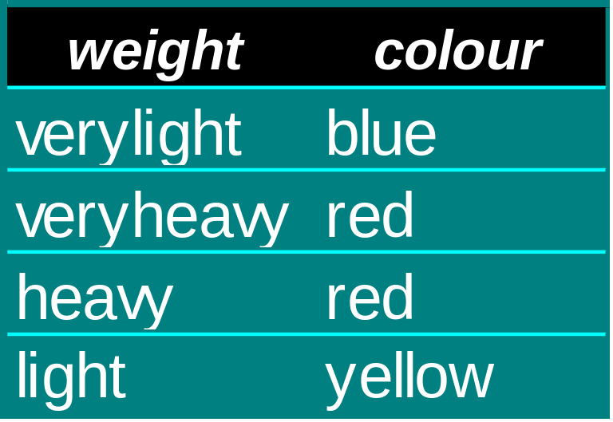
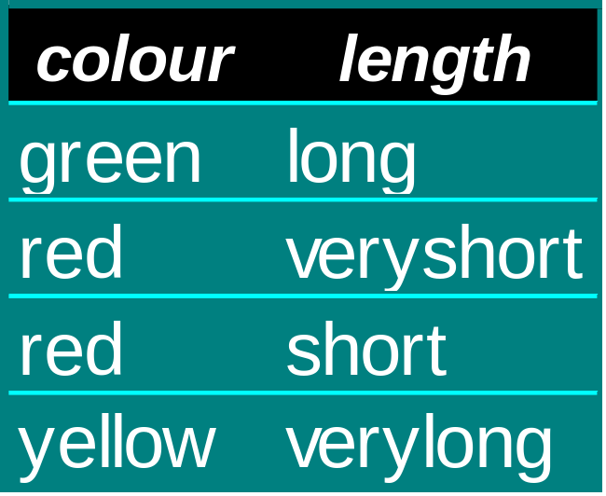
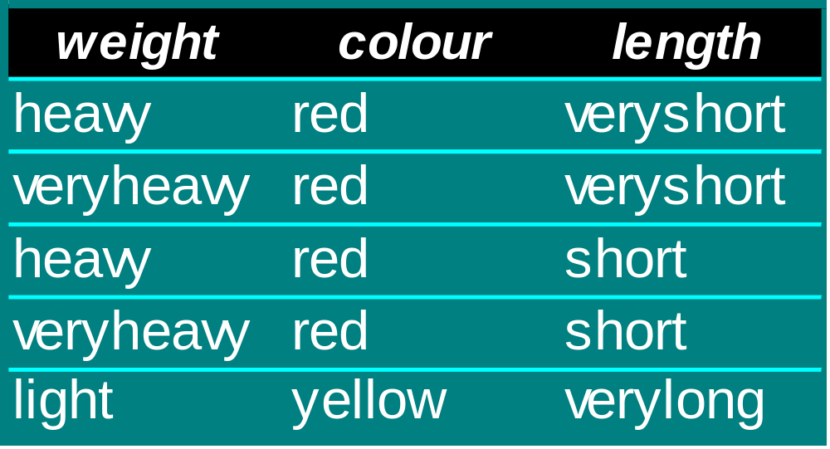
Join
Join

Slide 49
Θ-join
Join is based on equality
Θ-join is based on any condition
  (A TIMES B) where X Θ Y
if Θ is = we have an “equijoin”
  X and Y attributes same in all tuples
  eliminate one with projection
    we have “join”
Join is a projection of a restriction of a product
Try it out

Slide 50
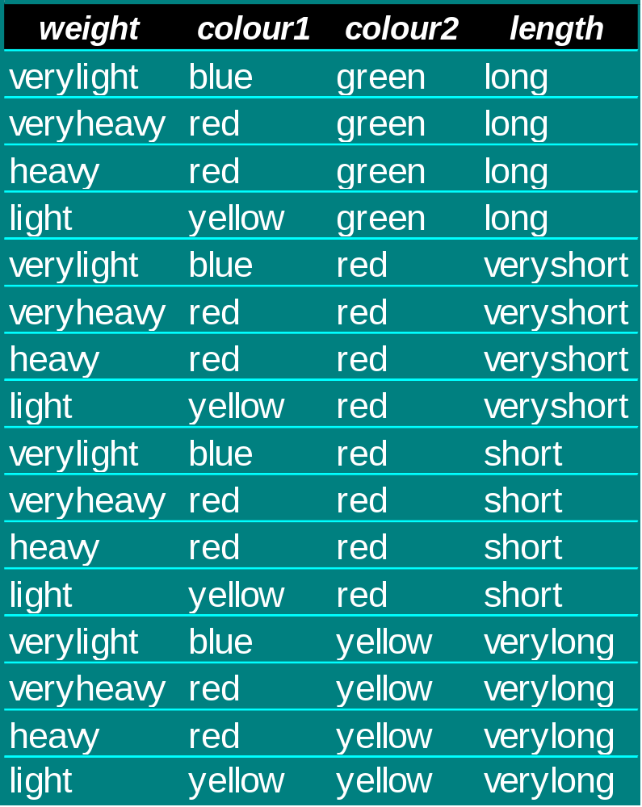
Product
How many tuples?

Slide 51
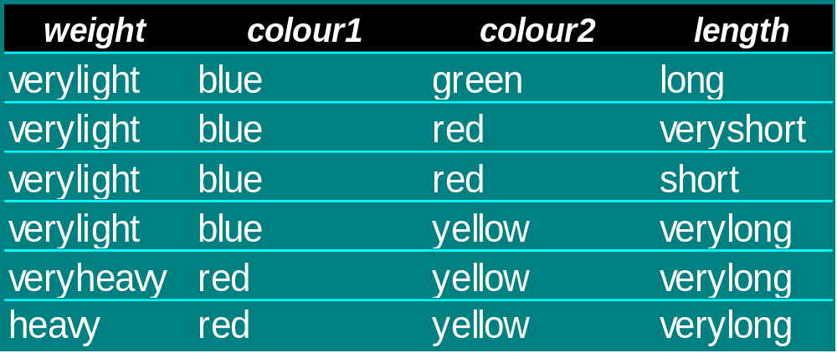
Less Than Join

Slide 52
Directional Joins
a heading consisting of:
  attributes found only in A
  attributes found only in B
  attributes found in both A and B (1 copy)
all the tuples from one relation
  only matching tupls from the other
Left Join or Right Join
Will result in Null values

Slide 53
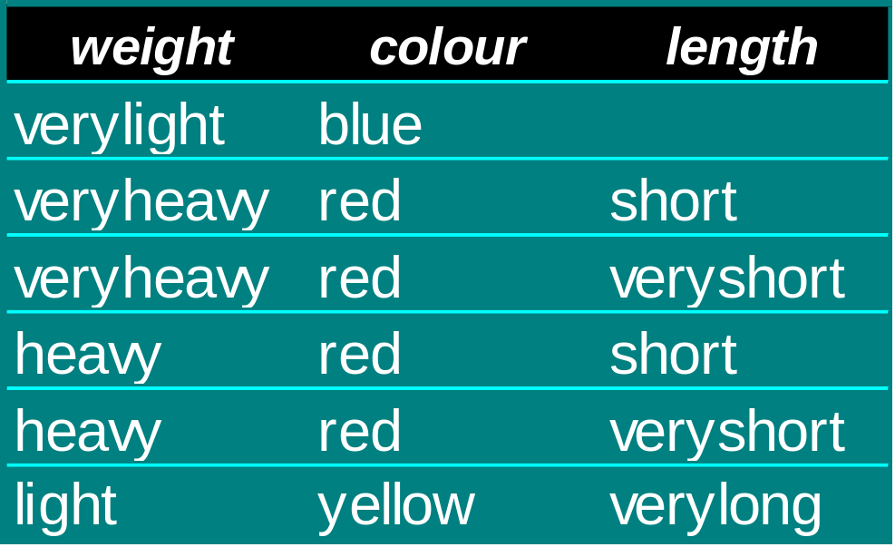
Left Join

Slide 54
Division
Given A{X,Y} and B{Y}
division returns a relation with
  heading X
  tuples for which A has an {X,Y} for all Y in B
X and/or Y can be multiple attributes

Slide 55
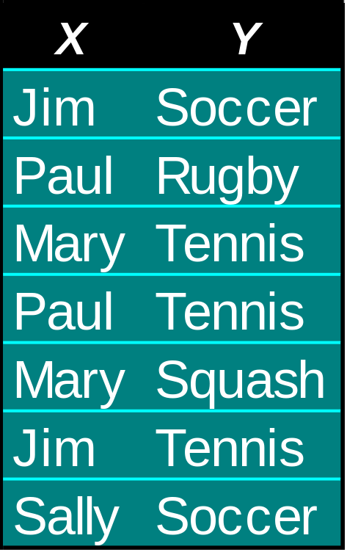


Division
DIVIDEBY
Returns

Slide 56
2 additional operators
Many have been proposed
These have widespread value and are illustrative
  extend
  summarize

Slide 57
Extend
Adds a new attribute calculated from one or more existing attributes
EXTEND relation ADD expression AS ATTRIBUTE
EXTEND item ADD (cost * 2.58) AS dollar
the expression can involve constants, attributes and other relations
Tours and Operators?

Slide 58
Summarize
“column-wise” computations - grouping
  c.f. “row-wise” in Extend
e.g.
SUMMARIZE R by (A1)
add sum (A2) as Total
Return a relation with
  heading (A1,Total)
  a tuple for each distinct value of A1 in R containing the total of A2 values over them

Slide 59
Summarize - notes
Can be “by” more than one attribute
  projection plus one attribute
Can be “by” no attribute
  grand total (or other calculation)
Tours and Operators?

Slide 60
Experimenting with Access
The weight/colour/length examples are available in Access

Slide 61
Relation assignment
So far it has all been expressions
  need a syntax for storing the result
  in named relations
The existing heading and tuples in a relation will be “overwritten”
e.g.
  A = B UNION C (c.f. arithmetic)
  X = X UNION Y (adding to table)

Slide 62
Updating relations
Could use assignment with destination relation in the expression
  error conditions not then handled
    addition of duplicate tuple
    deletion of non-existent tuple
Specific update operations handle this:
  insert
  update
  delete

Slide 63
insert
Source and target relations
  must be type compatible
All tuples of source inserted into target
  set operation
Source and target can be expressions
insert (A where x > 1 or y = 42) into B

Slide 64
update
Change specified attribute values in specified tuples of a relation
  expression to identify the restriction of a relation
  assignments to set attributes
  update (A where model = “delux”)
  colour = “red”
  trim = “gold”
set of tuples changed
  may be set of 1

Slide 65
delete
Identified tuples from a relation
  again, a set of tuple
delete A where length > 42

Slide 66
What is the algebra for?
Retrieval
  as expected
Update
  what parts change
Views
  virtual relations
Security
  define data under particular authorisation control
Concurrency control
  data to be protected
Integrity rules
  some parts of the data which must obey certain rules

Slide 67
Data Manipulation
End

